Slide 1
Special Congregational Meeting June 11th, 2023

Slide 2
Meeting Agenda
Welcome and Call to Order (President)
Notice of Call
Opening Prayer
Review the UCC Search & Call Process and the UMC Appointment Process to call a settled pastor
Review rationale to vote using paper ballots; and voting method on Zoom.
Procedure Votes
Motion to approve using a majority of votes to decide between UMC and UCC instead of a 2/3 vote.
Motion to approve accepting absentee ballots from a few members who are unable to attend.
Motion to decide between calling a UMC or UCC settled pastor.
Benediction
Adjournment

Slide 3
Notice of Call
NOTICE OF CALL is given herewith to the members of the Niantic Community Church, Inc. for a Special Meeting of the Congregation on Sunday, June 11, 2023, following the worship service, for the purpose of voting on which denomination (UCC or UMC) we will select for our settled pastor search.

Slide 4
Opening Prayer

Slide 5
Settled Pastor Search and Call Processes
On 23 April 2023, UMC and UCC representatives provided information on settled pastor search and call & appointment processes.
UCC: Rev. Isaac Lawson, Area Conference Minister, South Central Region
UMC: Rev. Wanda Santos-Pérez, Seacoast District Superintendent

Slide 6
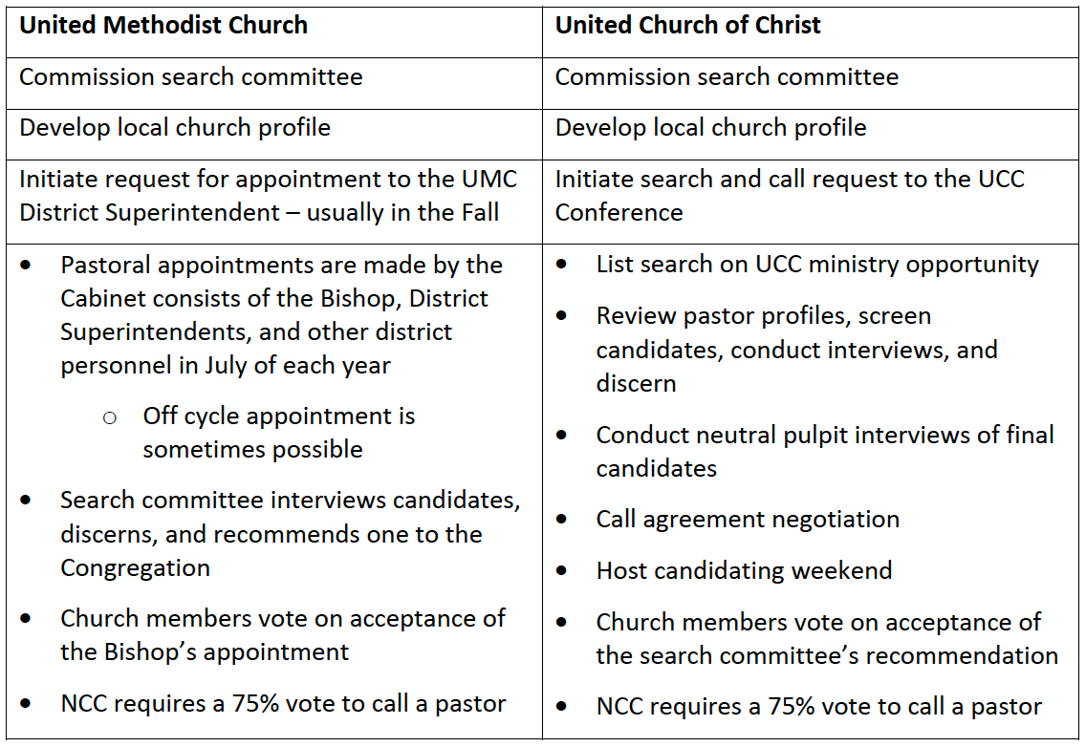
Summary of UMC and UCC Processes

Slide 7
Search Committee Members
UCC: Nancy Hunt, Peter Crizer, and Holly Buhler
NCC: Bette Mahon, Roe Granger, and Leyna Rasmussen
UMC: Verna Swann, Mary Mirecki, and Ellen Ashburn
On May 28th, 2023 we commissioned the Pastoral Search Committee, signifying the initiation of the search process.

Slide 8
Voting Methods
Only current church members may vote – by casting a ballot you attest that you are a member of NCC
We will use paper ballots for the vote to decide between UCC and UMC, because
Order of UMC or UCC matters
Raising hands to vote may be uncomfortable for some people and can challenge or sway their true vote. Some may not vote at all for other reasons.
Zoom voting
Members on zoom may submit their vote via Chat to the Tech Team (Host) only, their votes will not be shown on screen.

Slide 9
Procedural Votes
Motion to approve a super majority of votes to decide between UMC and UCC instead of a 2/3 vote.
Motion to approve accepting absentee ballots from a few members who are unable to attend.

Slide 10
Motion to decide between calling a UMC or UCC settled pastor.

Slide 11
Benediction by Rev. Dr. Eric Elnes Adjournment

Slide 12
Backup Slides

Slide 13
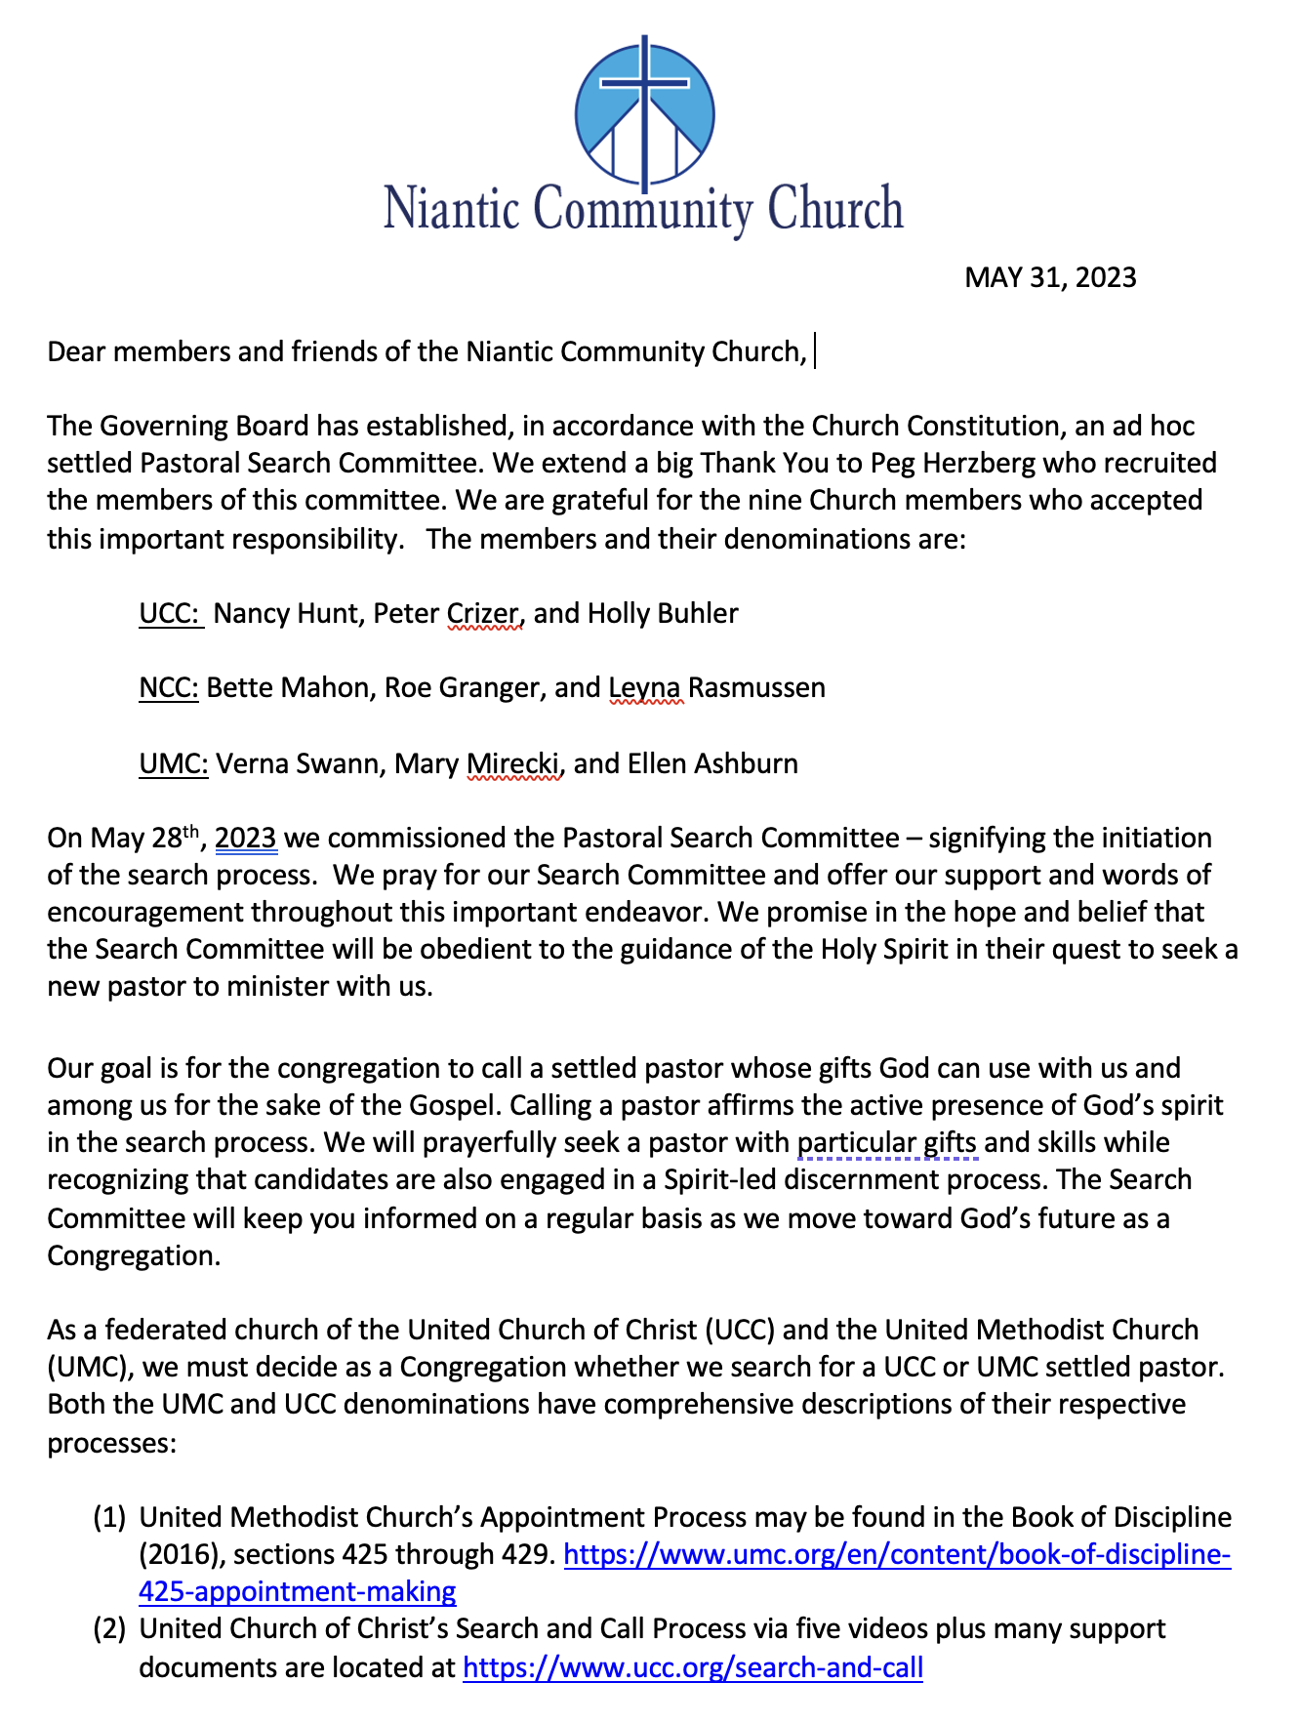
President’s Letters on March 28 and May 31, 2023

Slide 14
NCC Pastors During the Past 70 Years
UMC senior settled pastors – 36 years
UCC senior settled pastors – 29 years
UCC interim pastors – 5 years
UCC co-pastors/associate pastors – 19 years
UMC associate pastor - < 1 year

