Slide 1
Quarterly Congregational Meeting July 16th, 2023

Slide 2
Notice of Call (Clerk)
Notice is hereby given, pursuant to the Constitution of the Niantic Community Church, that the congregation will hold a meeting on Sunday, July 16th, 2023 after the worship service.

Slide 3
Opening Prayer (Rev. Kaleigh Rasmussen)

Slide 4
Meeting Agenda
Welcome and Call to Order
Notice of Call (Clerk)
Opening Prayer (rev. Kaleigh)
Motion to approve Quarterly Congregational Meeting (4/23/2023) minutes
Motion to approve Special Congregational Meeting (6/11/2023) minutes
Governing Board Report
Reports to inform the Congregation
Financial Reports – information only (Treasurer)
Ministry Team Report – Financial Management (Gail SanJuan)
Holy Land Pilgrimage Update (Rev. Dr. Eric Elnes)
Stewardship Campaign Update (Pam Stevens/Ralph Bates)
Status update on settled pastor search (Settled Pastor Search Committee)
Ministry Team Report – Property Management and Technology (Craig Woody)
Motion to approve Narthex Mezzanine Floor Reinforcement Proposal
Voices of the Congregation
Benediction (Rev. Eric)
Adjournment

Slide 5
Motion to Approve the Quarterly Congregational Meeting Minutes (held on 23rd April 2023)

Slide 6
Motion to Approve the Special Congregational Meeting Minutes (held on 11th June 2023)

Slide 7
Governing Board Report
Attendance for the last two quarters
Governing Board and Congregational decisions in 2023
Governing Board nominations for 2024
Fiscal Sponsor Agreement between NCC and Eden Tree Foundation (Rev. Elenes, Executive Director)

Slide 8
Worship Service Attendance

Slide 9
Governing Board Decisions
Niantic Community Church enacted a new governing structure in 2022 with ten voting members (four officers and six ministry team leaders). The board employs a deliberate and open process to conduct its business where all major business items were thoroughly explored prior to voting.
Table GB-1: 2023 Governing Board Motions and Decisions^{[1]}
¹Routine motions to approve meeting minutes, monthly financial reports, and adjournments are not included unless there are controversies.

Slide 10
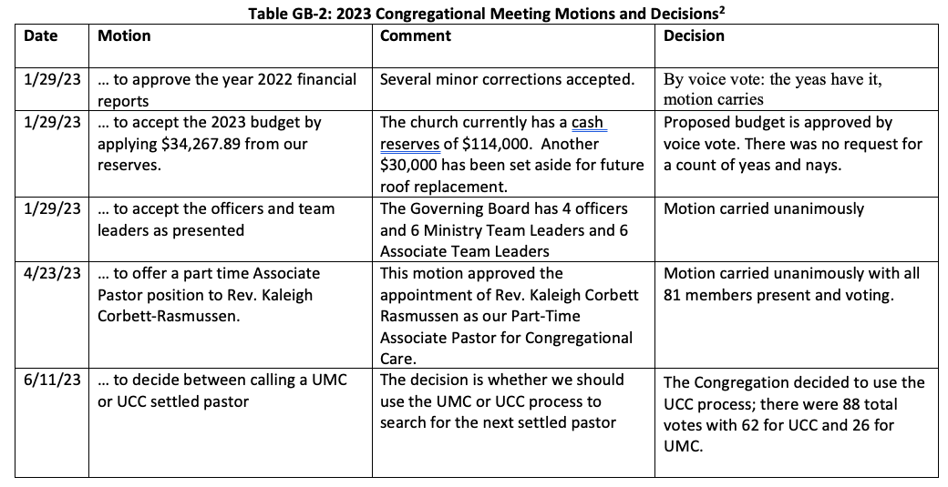
Congregational Decisions
²Routine motions to approve previous Congregational meeting minutes and adjournments are not included unless there are controversies.

Slide 11
Governing Board Nomination for 2024 (Officers)
President is term limited to two consecutive years of service. This is the ONLY Governing Board position that has an explicit term limit.
Current Vice President declines to succeed as President.
Treasurer has no term limit and can continue to serve. This is a position of great complexity such that a longer tenure is warranted.
Clerk has less than two years of service at the end of the 2023 term.

Slide 12
Governing Board Nomination for 2024 (Ministry Teams)
All Ministry Team Leaders and Associate Leaders have a minimum one-year term and may elect to serve an optional second year with Congregational approval.
After two (2) years, Ministry Leaders and Associate Leaders may elect to be nominated to a new term in the same ministry team or a different team, subject to Congregational approval. The NCC Constitution imposes no term limits for these positions though it is prudent for the incumbents to limit their consecutive service to four (4) years in the same team.
Associate leaders and current team members are encouraged to move up to Ministry Team leadership positions, subject to Congregational approval.
Church members who are not currently Team Leaders or Associate Leaders are encouraged to accept nominations to lead ministry teams they feel called to serve.

Slide 13
Fiscal Sponsor Agreement
The Financial Resource Ministry Team recommends NCC to enter into a Fiscal Sponsorship Agreement with the Eden Tree Foundation. The Rev. Dr. Eric Elnes is the Executive Director of Eden Tree Foundation.
Eden Tree’s mission is to employ present and emerging technologies for spiritual exploration and growth while fostering interfaith understanding, empathy, and community (the “Project”).
This agreement enables Eden Tree to receive tax-deductible contributions from donors to support its mission.
NCC president, vice president, and the treasurer concur with the Financial Ministry Team’s recommendation.
NCC president will sign the agreement for NCC.

Slide 14
What Is a Fiscal Sponsor?
A fiscal sponsorship involves an existing 501(c)(3) nonprofit offering to provide its tax-exemption and associated benefits to another group, usually a charitable project. The project should generally be aligned with the overall mission of the sponsoring charity.
For the Sponsors (NCC)
NCC is responsible to ensure donated funds are used in accordance with the project’s mission.
NCC receipts the donors for tax deduction purposes.
NCC must have sufficient visibility into the project to ensure it is operating in a manner consistent with 501(c)(3) requirements.
NCC designates funds for Eden Tree as a restricted funds (using a separate bank account).
NCC may terminate the agreement with 60-days notice for any reason.
For the Project (Eden Tree Foundation)
Eden Tree is subordinate to NCC in the context of this agreement.
Eden Tree submits regular financial reports to the sponsor.
Eden Tree is responsible to pay employment taxes and file all applicable employment tax documents associated with personnel compensation expenses.
Donations to Eden Tree must go through NCC to be recognized by the IRS as tax-deductible.
Eden Tree may terminate the agreement with 60-days notice for any reason.
This agreement expires two years from the date of the signed agreement

Slide 15
Reports to Inform the Congregation
Financial Reports – information only (Treasurer)
Ministry Team Report – Financial Management (Gail SanJuan)
Holy Land Pilgrimage Update (Rev. Dr. Eric Elnes)
Stewardship Campaign Update (Pam Stevens/Ralph Bates)
Status update on Settled Pastor Search (Settled Pastor Search Committee)
Ministry Team Report – Property Management and Technology (Craig Woody)

Slide 16
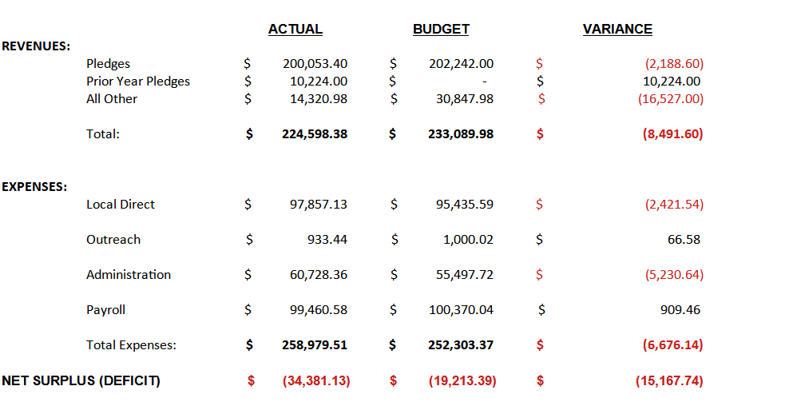
NIANTIC COMMUNITY CHURCH FINANCIAL REPORT SUMMARY June 2023

Slide 17
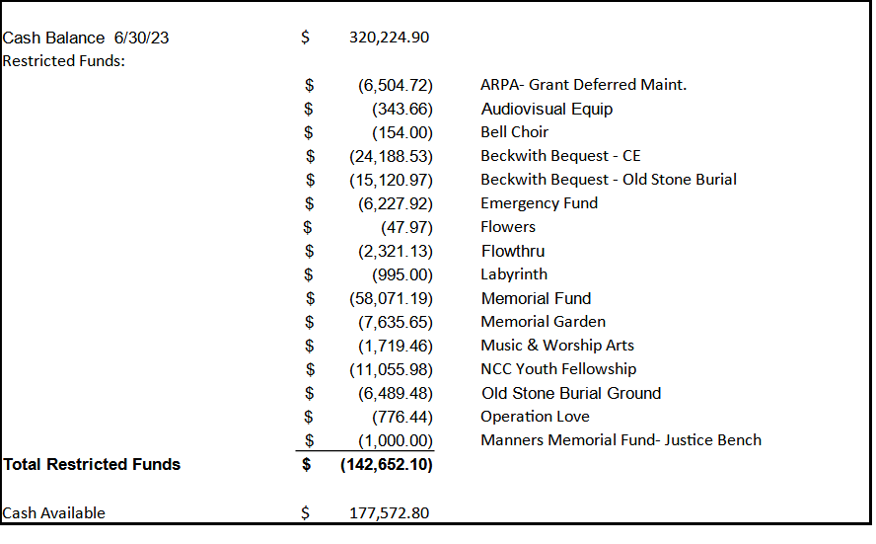
FINANCIAL REPORT – Restricted Funds

Slide 18
Ministry Team Report – Financial Management
Team Leader: Gail SanJuan
Team Members:
Liz Buhler (Treasurer)
Carol Donovan (Assistant Treasurer)
Ted Montgomtery (Financial Secretary)
Robin Goldschlager (Bookkeeper) Pam Stevens
Sue Smith
Sharon Kittel
Ralph Bates
Frank Chan (NCC President, non-voting).
Responsibilities:
Church Finance
Stewardship
Capital Campaign
Meet monthly on the second Monday at 7 pm. New members are welcome to attend.

Slide 19
Holy Land Pilgrimage Update Rev. Dr. Eric Elnes

Slide 20
Stewardship Campaign (Pam Stevens/Ralph Bates)
Stewardship is everything a church does in response to the Good News of God in Jesus Christ. It includes the combined and varied ministries of our members, friends, pastor, and staff. And it employs all our resources − namely our time, talents and money.
We are grateful for your faithful pledges throughout the years. Your gifts form the backbone of our ministry at Niantic Community Church (NCC) and make possible the things you love best about our church. Whether you attend worship occasionally or every Sunday, are involved in service projects, work with our youth, make music, share food, or strive for a more just and kind world, we Thank You!
We are starting the 2024 Stewardship Campaign a little earlier to ensure NCC has sufficient resources to continue and expand our ministries in 2024.

Slide 21
Search Committee for Settled Pastor
Who are we? Who are our neighbors?
Who is God calling Niantic Community Church to be?
July 16, 2023 Congregational Meeting Updates
Team Members
UCC: Nancy Hunt, Holly Buhler, Peter Crizer (Co-chair)
NCC: Bette Mahon, Rich Basham, Leyna Rasmussen (Clerk)
UMC: Verna Swann, Ellen Ashburn, Mary Mirecki (Co-chair)

Slide 22
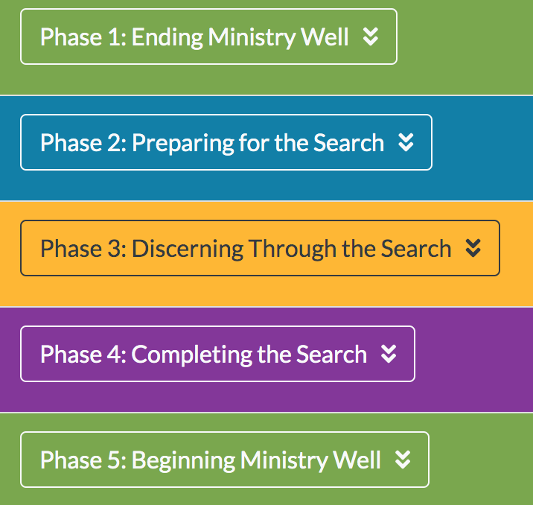
UCC Search & Call Journey
Source: https://www.sneucc.org/the-search-and-call-journey

Slide 23
UCC Search & Call Process: Phase II
“Preparing for the Search”
FORM COMMITTEE | → May 28: NCC Settled Pastor Search Committee Commissioned → June 11: NCC Congregation voted to follow UCC process for calling a pastor → June 15: Committee team member roles discerned Complete ✅
GATHER INFORMATION | → July 7: Hartford Institute (HI) Survey Distributed to Congregation → July 7 - 21: Congregation completes HI Survey
WRITE PROFILE | → Next: Search Committee writes profile Search committee started, but will need survey results to complete → Future: Submit Church Profile to UCC conference office UCC conference office posts profile online Wait and pray for candidates to submit their pastoral profile to NCC

Slide 24
UCC Search & Call Process: Phase III
“Discerning Through the Search”
RECEIVE PROFILES
INTERVIEW CANDIDATES
DISCERN TOWARD & WITH FINAL CANDIDATE

Slide 25
Ministry Team Report Property Management & Technology Craig Woody

Slide 26
Narthex Mezzanine Floor Reinforcement Proposal
Issue: The floor above the Narthex ceiling is not strong enough to be a safe place on which for people to move around or to store items. It is unsafe and does not meet current building codes.
Proposed solution: Build a properly designed floor above the Narthex ceiling that is sufficiently strong to safely support people and stored items.
Appearance: This proposal will not significantly change the appearance of sanctuary. A guard rail (required by code) will be installed to prevent people from falling.
Costs: There will be no cost to the church as the materials will be donated and the labor will be performed by volunteers with the requisite building skills.

Slide 27
An Example of the Completed Configuration

Slide 28
Motion to approve
Narthex Mezzanine Floor Reinforcement Proposal

Slide 29
Mark your Calendar 2023 Quarterly Congregational Meeting October 22nd

Slide 30
Voices of the Congregation

Slide 31
Adjournment Benediction – Rev. Dr. Eric Elnes

